Slide 1
Why does a God of love allow disasters to happen?
A reflection on disasters, resilience and faith

Slide 2
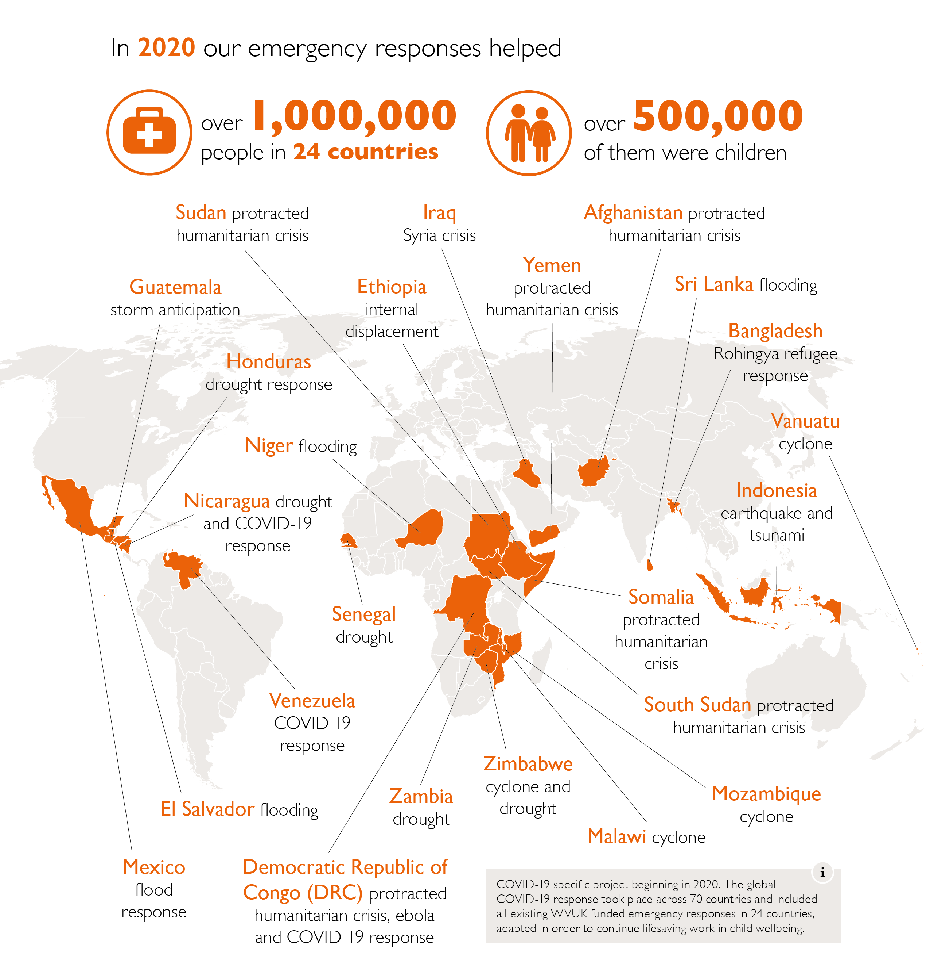

Slide 3
Disasters
Joseph – Old Testament
World Vision projects – Uganda
What do people say?
What does the bible say?
What do the academics say?

Slide 4
Sin?
Job 22:5
Luke 13:4-5
Matthew 5:45
Pat Robertson on Haiti earthquake: “pact to the devil brought on the devastating earthquake”
UKIP Councillor David Silvestre: “disasters would accompany the passage of his same-sex marriage bill”

Slide 5
Hazard x Vulnerability = Disaster

Slide 6
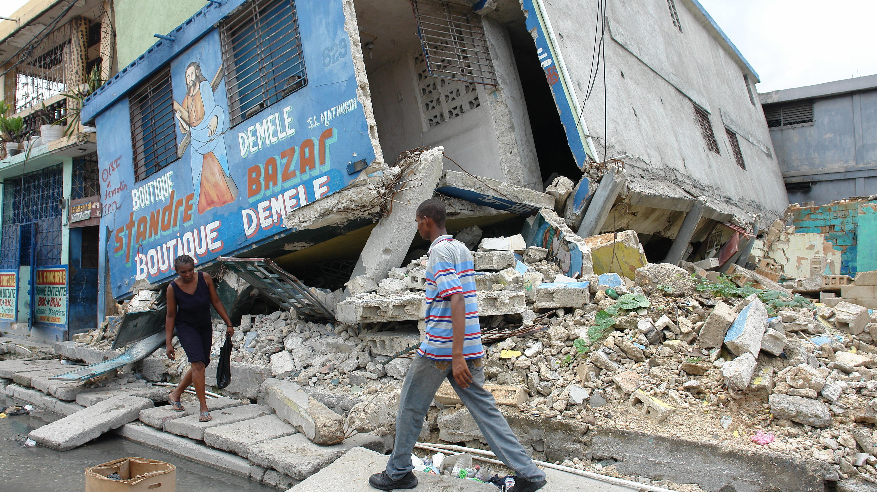
Haiti earthquake 2010

Slide 7
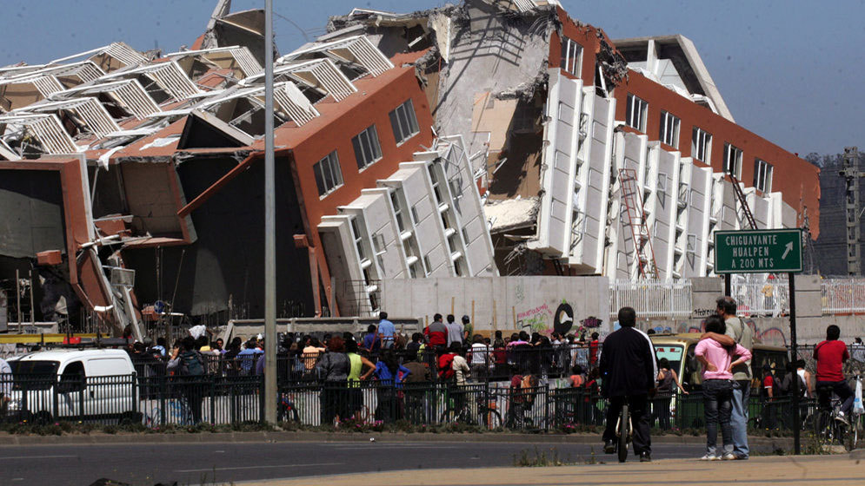
Chile earthquake 2010

Slide 8
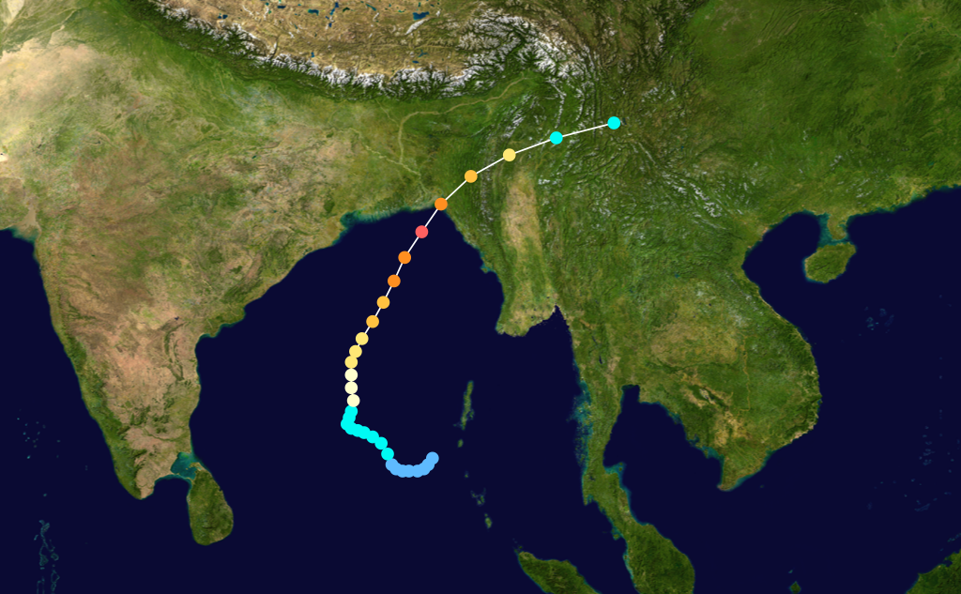
Bangladesh cyclone 1991

Slide 9
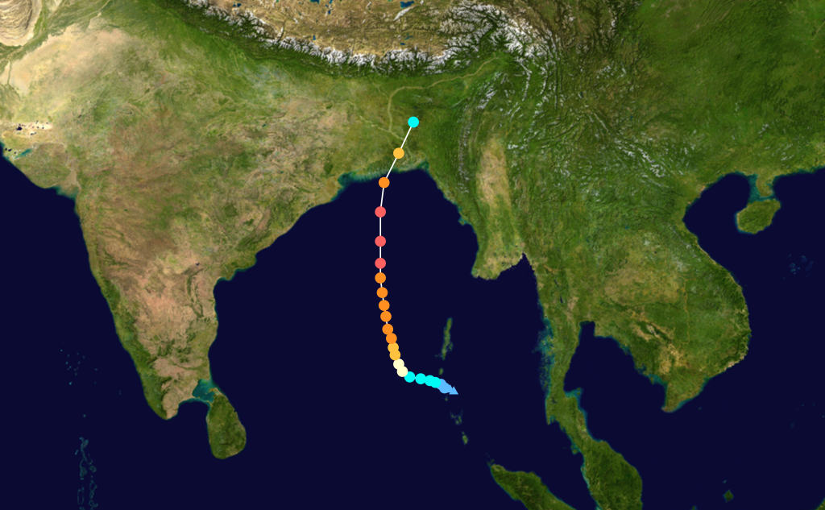
Bangladesh cyclone 2007

Slide 10
To reduce vulnerabilities…
Be better prepared
Mitigate risks
Build resilience

Slide 11

DROUGHT
MANAGEMENT POLICY

Slide 12







Slide 13
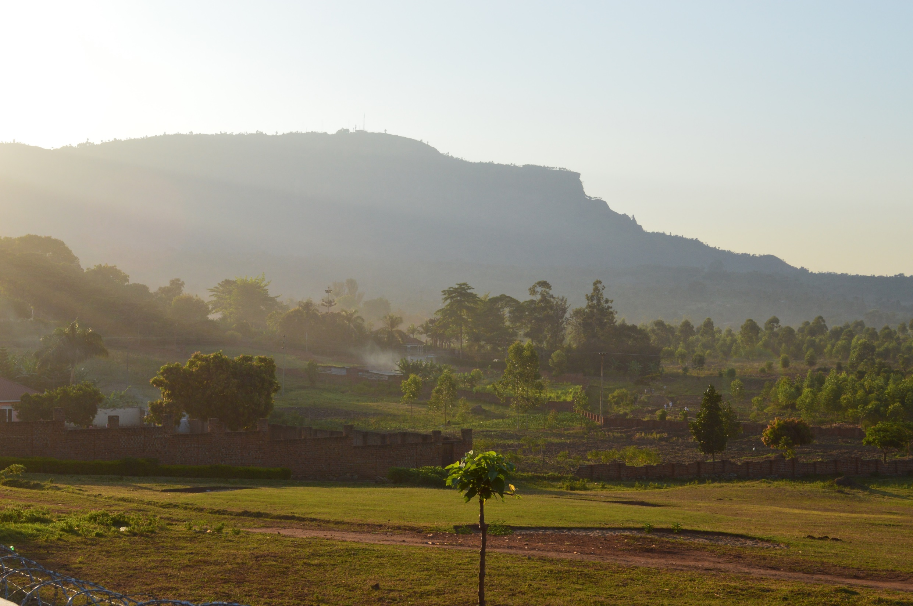
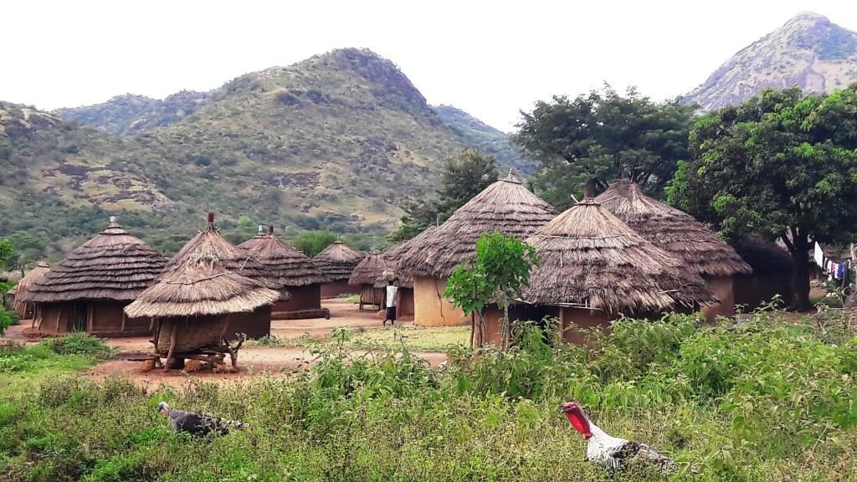
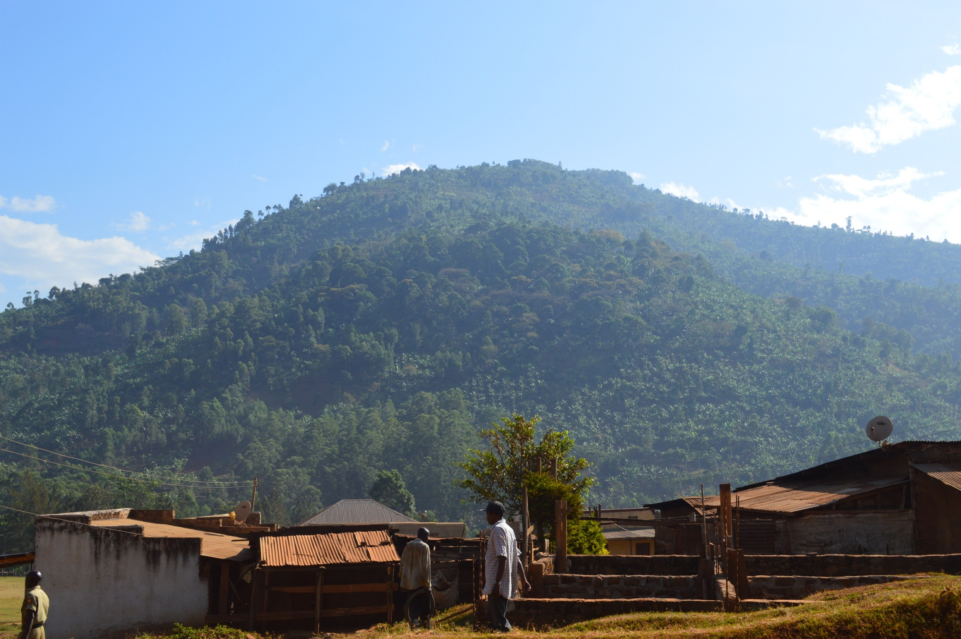
Forecasts translated into 22 local languages
200,000 people received translated weather forecasts
80% took positive actions to improve their resilience
Choosing particular crop varieties to plant
Planting on recommended dates
Taking pest control measures
Using soil conservation techniques
Planting trees

Slide 14
Remember…
Disasters aren’t a punishment from God
We can help people to be less vulnerable to natural hazards
Action on climate change will help to make the poorest less vulnerable

Slide 15
Pray for…
Farmers in countries like Uganda
Pray for those who help people rebuild after disasters

