Slide 1
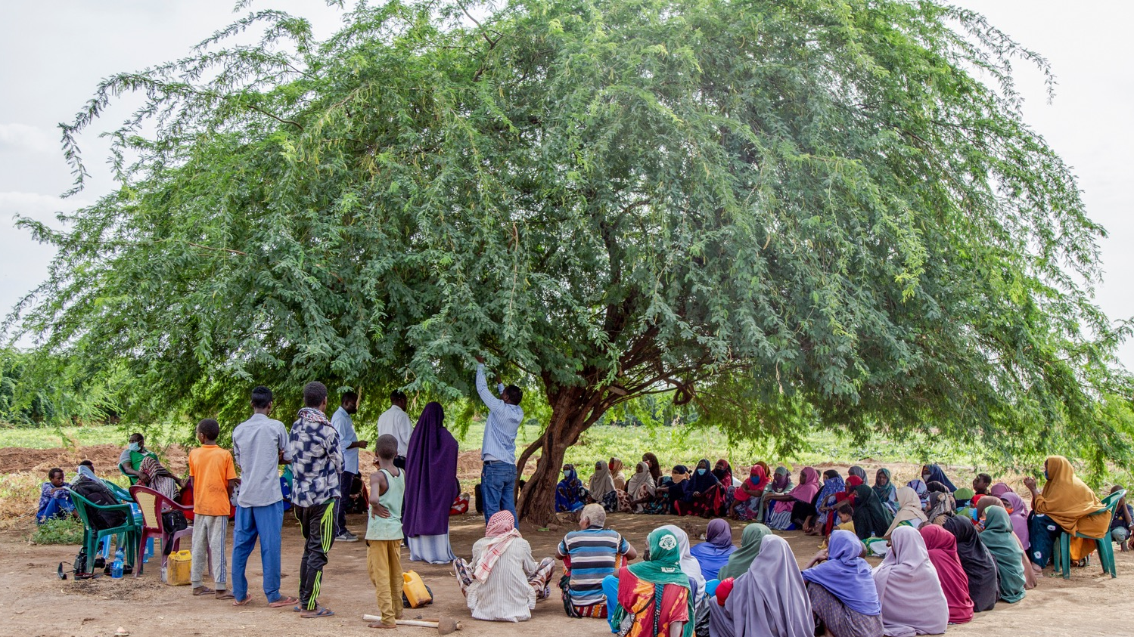
Trees of Life

Slide 2
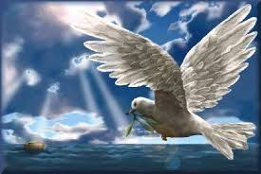
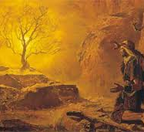
Trees in the bible
On the first page of the Bible
In the first Psalm
On the last page of Revelation
Noah – olive branch
Abraham – oak tree
Moses – burning bush
Joseph – vine
Zacchaeus – sycamore tree
Gentiles – olive tree branches

Slide 3
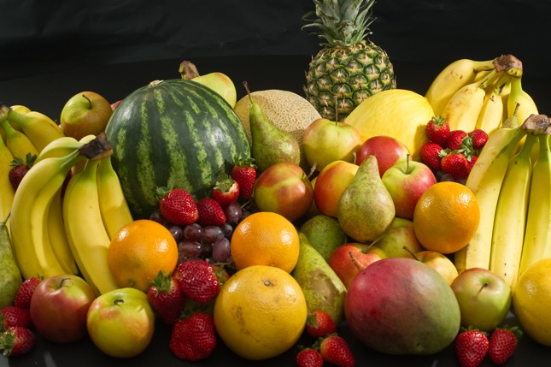
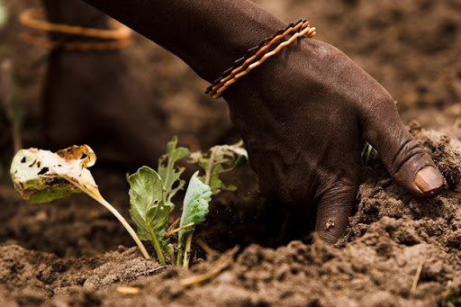
Community benefits of trees
Source of food – fruit, herbs
Fuel – wood or charcoal
Construction material
Help soil to absorb water
Promote biodiversity
Increase soil fertility

Slide 4
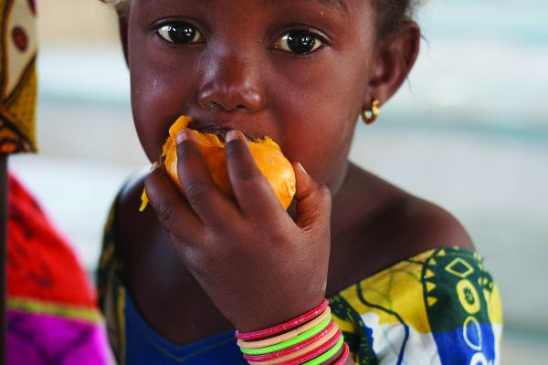
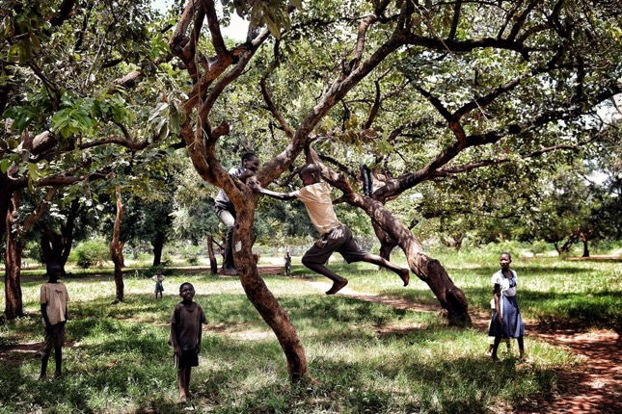
Child focused benefits of trees
Nutrition
Family income
Protection from disaster
A place to play

Slide 5
Daniel Chapter 4
¹⁴ Cut down the tree and trim off its branches; strip off its leaves and scatter its fruit. Let the animals flee from under it and the birds from its branches. ¹⁵ But let the stump and its roots, bound with iron and bronze, remain in the ground, in the grass of the field.

Slide 6
The underground forest

Slide 8
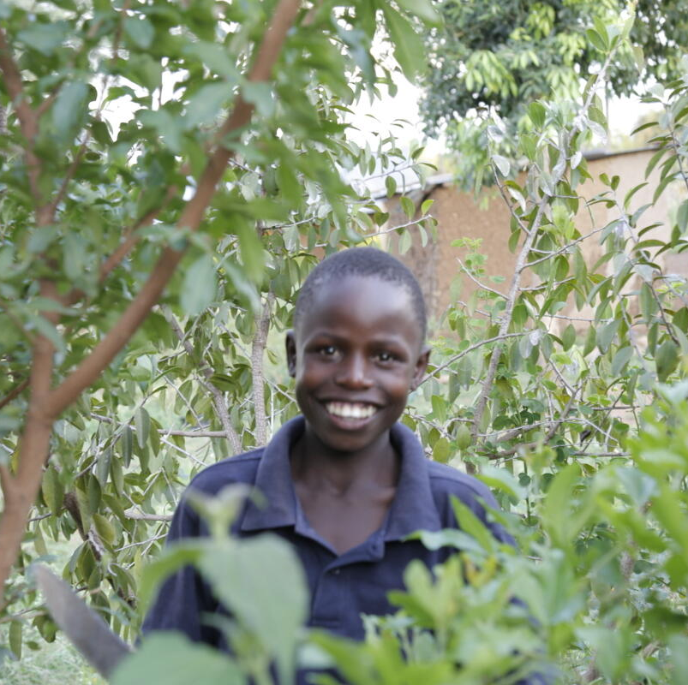
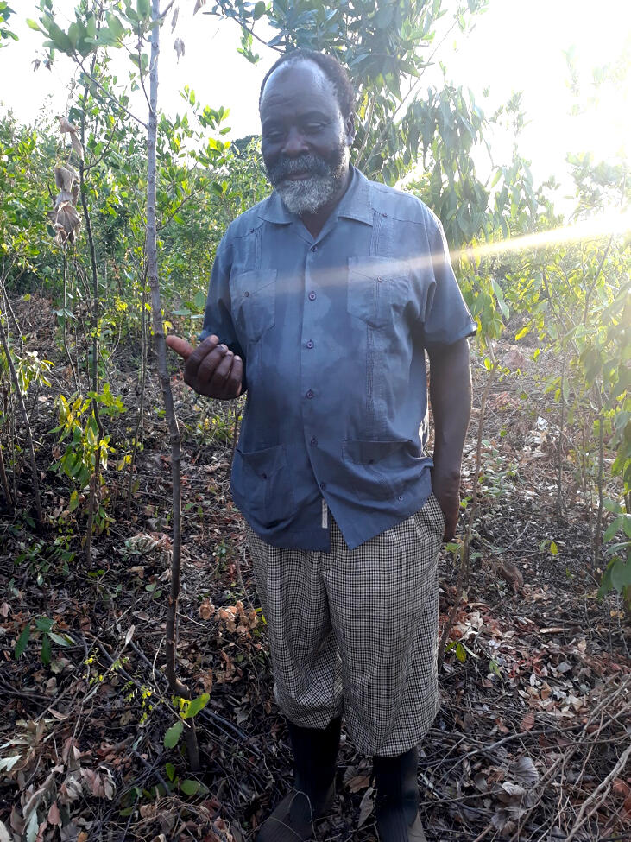
Naaman, 13, Kenya
Peter, FMNR champion

Slide 9
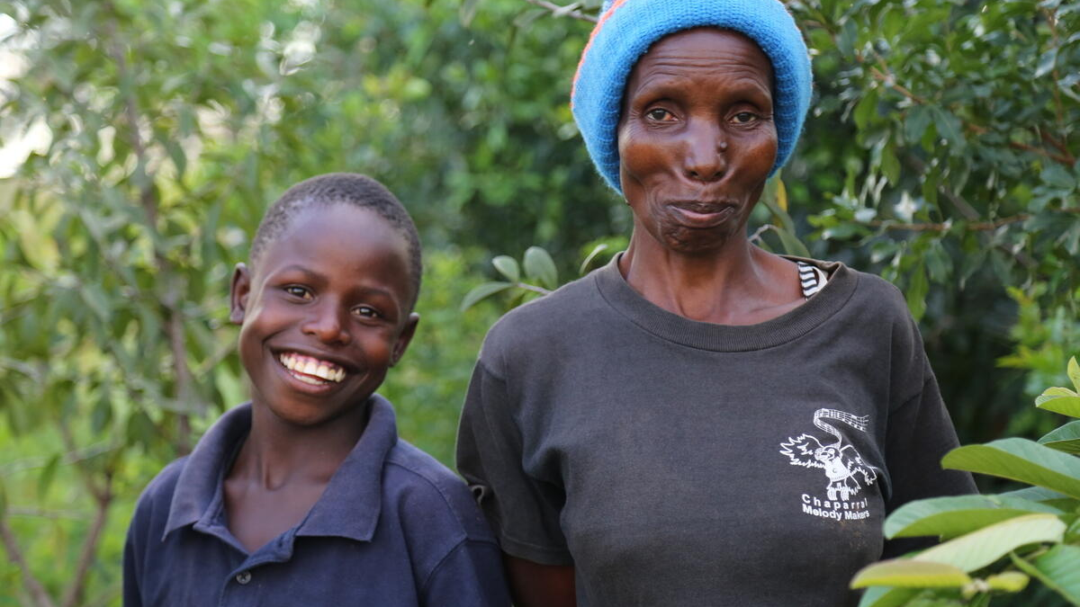
Naaman and Pamela

Slide 10
Remember…
People can adapt to climate change
Trees are important for stopping climate change and for adaptation
Regeneration can be better than tree planting
Increasing bio-diversity is also important

Slide 11
Pray for…
COP26 in November – for real change to reduce global emissions
For families like Naaman’s – for support to adapt to climate change
For all of us – to reduce our own carbon footprints

